Slide 1
Introduction to Programming(II) Week 05
李哲榮

Slide 2
Announcements
Midterm next Tuesday (4/2) 13:20-15:20
EECS 326/328
3 questions, 15 test cases
Practices are online http://acm.cs.nthu.edu.tw/contest/1632/
Written exam is on 4/9
Will give a sample exam this week
Mini-project 1 is due on 4/16

Slide 3
Today’s work
How to use partial judge?
How to use debugger?
Concepts rejuvenation: how to think the problem
Linked list:
Recursion:
Binary tree:
Parser:

Slide 4
Linked list
Understand the structure
Key ideas:
draw figures
Take care of special cases (head, tail, …)
12163 - Linked List (Quiz 2)
typedef struct _Node {
int data;
struct _Node *next;
} Node;
data
next

Slide 5
Recursion
Key ideas:
What are stop step and recursion step?
How to pass parameters?
11270 – reverse linked list (HW1) using recursion

Slide 6
Binary tree
Familiar with the binary tree structure
Familiar with the properties of binary trees
The recursive relation of binary tree
Familiar with the traversal methods
Pre-order, in-order, post-order
12193 - Binary Search Tree Operation

Slide 7
Parser
Combine strings operations with binary tree
Keys:
String functions: scanf, getchar, putchar, …
Relation to binary tree traversal
Prefix, infix, postfix
Gramma: recursive definition of syntax.
10984 - Prefix to syntax tree
10966 - Infix to syntax tree

Slide 8
Assembly

Slide 9
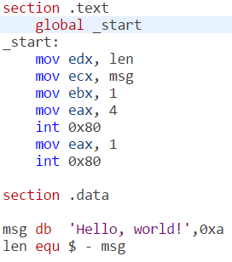
What is assembly?
C codes (or any high level programs) are very different from the machine code
01101001001001001101010101010010100101010101010101101010101011101101010101110010101010101011010110...
#include <stdio.h>
int main(){
printf(“Hello World!”);
return 0; }
Answers:
Human readable
One to one to machine code

Slide 10
How to get the assembly code?
In the terminal, use gcc -S ex1.c to get the assembly code of ex1.c
In today’s lecture, we use x86 CPU and intel style’s assembly
gcc -S -masm=intel ex1.c
To generate executable, you can compile the assembly code directly
gcc ex1.s

Slide 11
From C to Assembly code

Slide 12
Example 1: assignment 1
C code
Assembly code
int a;
int main(void){
a = 3;
}
mov DWORD PTR _a, 3

Slide 13
MOV instruction
MOV is an instruction in x86’s architecture
In example 1, destination is a memory address, named _a, and source is a constant value (3).
DWORD specifies the data size.
MOV destination, source
Type Specifier | Bytes addressed
BYTE | 1
WORD | 2
DWORD | 4
QWORD | 8

Slide 14
Example 2: assignment 2
C code
Assembly code
What’s differences between ex1 and ex2?
int main(void){
int a;
a = 3;
}
mov DWORD PTR [esp+12], 3

Slide 15
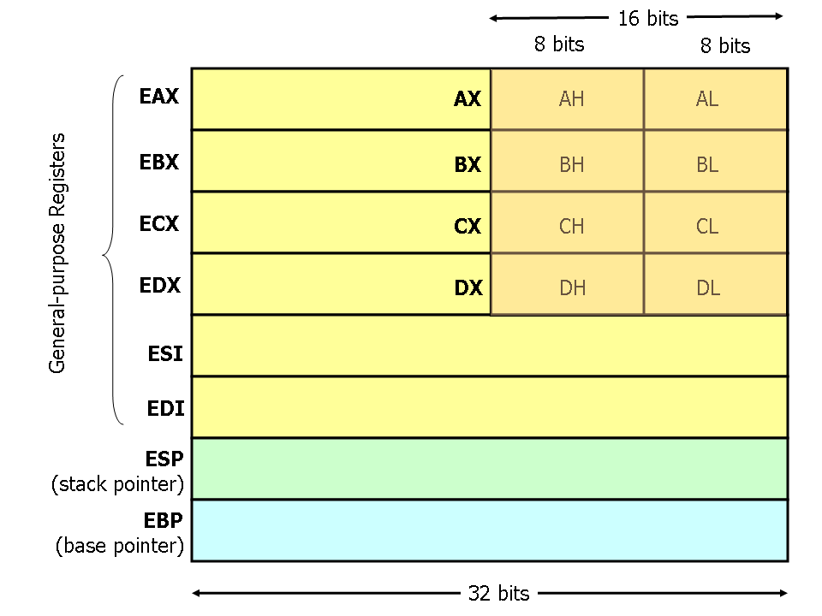
Registers in x86 CPU
Notes:
For the game, draw this on the blackboard.

Slide 16
Indirect memory access
Register esp holds an address of memory.
[esp+12] is a memory address, whose cell is 12 bytes below the memory cell addressed [esp].
Memory
Address
[esp]
[esp+04]
[esp+08]
[esp+12]
[esp+16]
Register esp

Slide 17
Analogy of seat arrangement
Number all seats from 0, 4, 8, …
Write a number on the blackboard as the content of esp.
Ask where is [esp+12], and put 3 to that seat.
Change the number of esp, and ask again.

Slide 18
Global variable vs. local variable
Variable a in example 1 is a global variable, and in example 2 is a local variable.
 | Global variable | Local variable
Creation | Program starts | Function is called
Life time | Program stops | Function returns
Copies | Only one | The number of function called.
Memory space | data segment or BSS segment | In the stack
Accessible | Everywhere | Within the function

Slide 19
Format of an .exe file
It consists of three parts
Information for the .exe file
File name, OS version, etc
Data segment
Initialized global variables
Static variables
Text segment
Executable instructions
File information
Data segment
Text segment
(code)

Slide 20
Runtime data structure
When a program is executed, the memory layout has an additional segment, stack, for function invocation, and an BSS segment for uninitialized data.
Memory
Harddisk
Stack segment
File information
BSS segment
Data segment
Data segment
Text segment
(code)
Text segment
(code)

Slide 21
Example 3: assignment 3
C code
Assembly code
eax is another register in x86 CPU
int main(void){
int a, b;
b = a;
}
mov eax, DWORD PTR [esp+12]
mov DWORD PTR [esp+8], eax
Notes:
Continue the game,
Ask each student to have a number in hand.
Put a number in esp, for example, 20
Ask what is the number of in [esp+12], put that to eax
Ask the student in [esp+8] to have the same number

Slide 22
Syntax of MOV
In the syntax of MOV, none of them are destination=mem and source=mem
Why?
<mem> can be a direct address or an indirect address
A single b=a needs 2 instructions.
MOV destination, source
Valid MOV syntax
mov <reg>,<reg> mov <reg>,<mem> mov <mem>,<reg> mov <reg>,<const> mov <mem>,<const>

Slide 23
Example 4: Add
C code
Assembly code
eax, edx are registers in x86 CPU
int main(void){
int a, b, c;
c = a + b;
}
mov eax, DWORD PTR [esp+8]
mov edx, DWORD PTR [esp+12]
add eax, edx
mov DWORD PTR [esp+4], eax
Notes:
Continue the game,
Ask each student to have a number in hand.
Put a number in esp, for example, 20
Ask what is the number of in [esp+8], put that to eax
Ask what is the number of in [esp+12], put that to edx
Perform add eax, edx
Ask the student in [esp+4] to have the number in eax

Slide 24
ADD instruction
The add instruction adds together its two operands, storing the result in its first operand.
Ex: add BYTE PTR [var], 10
add 10 to the single byte stored at memory address var
Ex: add eax, 10
EAX ← EAX + 10
Valid add syntax
add <reg>,<reg> add <reg>,<mem> add <mem>,<reg> add <reg>,<con> add <mem>,<con>

Slide 25
Example 5: If-else
C code
Assembly code
int main(void){
int a, b;
if (a>3) b++;
}
cmp DWORD PTR [esp+12], 3
jle L3
add DWORD PTR [esp+8], 1
L3:
leave
Notes:
Continue the game,
Ask each student to have a number in hand.
Put a number in esp, for example, 20
Ask what is the number of in [esp+8], put that to eax
Ask what is the number of in [esp+12], put that to edx
Perform add eax, edx
Ask the student in [esp+4] to have the number in eax

Slide 26
Cmp and jle instructions
cmp compares the values of the two specified operands, setting the condition codes in the machine status word.
Machine status word is another register in x86 CPU
jle <label> jumps to the label if the machine status word shows “less than or equal to”

Slide 27
Conditional jump
je <label> (jump when equal)
jne <label> (jump when not equal)
jz <label> (jump when last result was zero)
jg <label> (jump when greater than)
jge <label> (jump when greater than or equal to)
jl <label> (jump when less than)
jle <label> (jump when less than or equal to)

Slide 28
Instruction pointer (IP)
The program (a list of instructions) is stored in memory.
Which instruction to be executed is specified by a special register, called instruction pointer.
In some place, it is called “program counter” (PC).
Normally, IP increases 4 bytes (an instruction). But for jump <label>, it will become the address of the instruction after the label.
<label> represents a memory address.
Notes:
Play the game that give 5 students the following instructions
模擬一下不同的執行
1.call ___main
2. cmp DWORD PTR [esp+12], 3
3. jle L3
4. add DWORD PTR [esp+8], 1
L3:
5. leave

Slide 29
Example 6: while loop
int main(void){
int a, b;
while(a<=3) b++;
}
C code
Assembly code
jmp L2
L3:
add DWORD PTR [esp+12], 1
L2:
cmp DWORD PTR [esp+8], 3
jle L3
leave
Notes:
Continue the game,
Ask each student to have a number in hand.
Put a number in esp, for example, 20
Ask what is the number of in [esp+8], put that to eax
Ask what is the number of in [esp+12], put that to edx
Perform add eax, edx
Ask the student in [esp+4] to have the number in eax

Slide 30
jmp instruction
jmp <label> transfers program control flow to the instruction at the memory location indicated by the operand (<label>).
Instruction jmp is called “unconditional jump”

Slide 31
Different implementation
The implementation is not unique.
int main(void){
int a, b;
while(a<=3) b++;
}
L3:
cmp DWORD PTR [esp+8], 3
jg L2
add DWORD PTR [esp+12], 1
jmp L3
L2:
leave

Slide 32
GCC Inline Assembly

Slide 33
Combine C and assembly
Sometime we need to combine C and assembly code
To improve the performance
To write the code for low level device drivers
How to combine C and assembly is compiler dependent, not a standard.
We will use gcc’s inline assembly to introduce the idea.

Slide 34
Basic structure of inline assembly
Basic structure
asm(
assembler template // 組合語言程式
: output operands // 輸出參數列表
: input operands // 輸入參數列表
: list of clobbered registers
//被更改的暫存器列表
);

Slide 35
Example 7: inline assembly
#include <stdio.h>
int main(void){
int foo = 10, bar = 15;
asm(
"add %%ebx,%%eax"
:"=a"(foo)
:"a"(foo), "b"(bar)
);
printf("foo=%d\n", foo);
return 0;
}
assembler template
output operands
input operands

Slide 36
Advanced syntaxes in assembly

Slide 37
Example 8: pointer
int main(void){
int a;
int *pa;
pa = &a;
}
C code
Assembly code
lea eax, [esp+8]
mov DWORD PTR [esp+12], eax

Slide 38
lea instruction
The lea (Load effective address) instruction places the address specified by its second operand into the register specified by its first operand.
Note, the contents of the memory location are not loaded, only the effective address is computed and placed into the register.
This is useful for obtaining a pointer into a memory region.

Slide 39
Example 9: pointer 2
int main(void){
int a;
int *pa;
pa = &a;
*pa = 3;
}
C code
Assembly code
lea eax, [esp+8]
mov DWORD PTR [esp+12], eax
mov eax, DWORD PTR [esp+12]
mov DWORD PTR [eax], 3

Slide 40
lea eax, [esp+8]
mov DWORD PTR [esp+12], eax
mov eax, DWORD PTR [esp+12]
mov DWORD PTR [eax], 3
Memory
Address
[esp]
Register esp
[esp+04]
3
[esp+08] (a)
[esp+12] (pa)
Register eax

Slide 41
Example 10: array
C code
Assembly code
int main(void){
int a[3];
a[0] = 2;
a[1] = -6;
a[2] = 10000;
}
mov DWORD PTR [esp+4], 2
mov DWORD PTR [esp+8], -6
mov DWORD PTR [esp+12], 10000

Slide 42
Array and pointer
Array | Pointer
A continuous space to store the data of the same data type | A space that stores the address of a specific type of data
a[2]: the third element in that continuous space | *(pa+2): the element that is 2 units away from the element pointed by pa
An array a is a “reference” of a space, which cannot be changed. | A pointer pa can change its content to point to other addresses.

Slide 43
Example 11: function call
C code
Assembly (call foo)
int foo(int a){
return a+1;
}
int main(void){
foo(3);
}
mov DWORD PTR [esp], 3
call _foo

Slide 44
C language calling convention
The calling convention is a protocol about how to call and return from functions.
Two instructions for function call and return
Call: push the current code location onto the hardware supported stack; unconditional jump to the code location indicated by the label operand.
Ret: pop the current code location from the hardware supported stack; unconditional jump to the popped code location.

Slide 45
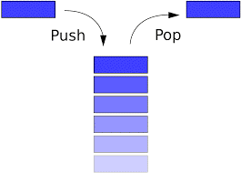
Stack
A stack is a data structure that has two operations: push and pop
push adds an element to the collection;
pop removes the last element that was added.
Elements are only allowed to be added and removed from the “top” of a stack
First come last out

Slide 46
Hardware supported stack
x86 CPU has a hardware support stack
Two instructions: push and pop
Register esp (stack pointer): point to the stack top
Register ebp (base pointer): point to the stack base
Used for function calls
Subroutine parameters are passed on the stack.
Registers are saved on the stack, and
local variables used by subroutines are placed in memory on the stack.

Slide 47
The flow of a function call
Caller calls the function
Callee starts the function
Callee performs the function
Callee returns
Caller restores
Caller: the one makes the function call
Callee: the called function

Slide 48
Caller rules to call function
Before calling a function, push the contents of certain registers to the stack.
The caller-saved registers are EAX, ECX, EDX.
To pass parameters to the subroutine, push them onto the stack before the call.
To call the function, use the call instruction.
Instruction call pushes the return address on top of the parameters on the stack, and jumps to the function code.

Slide 49
Callee rules to start a function
Push the value of EBP onto the stack, and copy the value of ESP into EBP
Allocate local variables by making space on the stack.
Push the values of the callee-saved registers that will be used by the function.
The callee-saved registers are EBX, EDI, and ESI

Slide 50
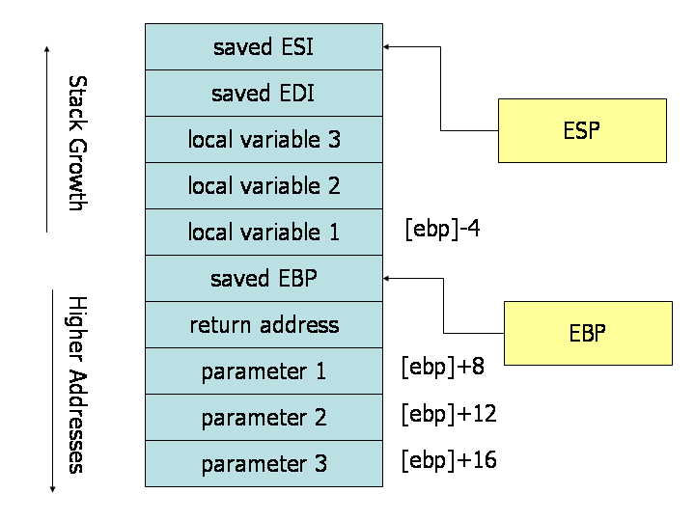
Function call memory layout

Slide 51
Callee rules to return
Leave the return value in EAX.
Restore the old values of any callee-saved registers (EDI and ESI) that were modified.
Deallocate local variables.
Before returning, restore the caller's base pointer value by popping EBP off the stack.
Return to the caller by executing a ret instruction.

Slide 52
Caller rules to restore
Find the return value of function in the register EAX.
Remove the parameters from stack.
This restores the stack to its state before the call was performed.
Pop off the contents of caller-saved registers (EAX, ECX, EDX) from the stack.
The caller can assume that no other registers were modified by the callee.

Slide 53
References
http://www.cs.virginia.edu/~evans/cs216/guides/x86.html
http://www.nasm.us/pub/nasm/releasebuilds/2.09.02/win32/nasm-2.09.02-win32.zip
http://eli.thegreenplace.net/2011/02/04/where-the-top-of-the-stack-is-on-x86/
http://www.ibiblio.org/gferg/ldp/GCC-Inline-Assembly-HOWTO.html
http://ccckmit.wikidot.com/as:inlinec
陳鍾誠 (2010年10月11日)，(網頁標題) 組合語言 — 在 C 語言當中內嵌組合語言，(網站標題) 陳鍾誠的網站，取自http://ccckmit.wikidot.com/as:inlinec ，網頁修改第 0 版。

